Slide 1



Group project
Group 9
Online shopping system
Group member: Hongqian Zhao
Xiaoqing Lu

Slide 2

Program summary
An online shopping system which contains log in/sign in system, user info in the database, and allows user to leave comments to the items.
User can check their profile to see their shopping cart, and can use the sort system to search the item.
User can leave their valuable comment on the item page.
We use the we chat to connect and share our project.
Live URL: https://zhao16q.myweb.cs.uwindsor.ca/comp3340/project

Slide 3
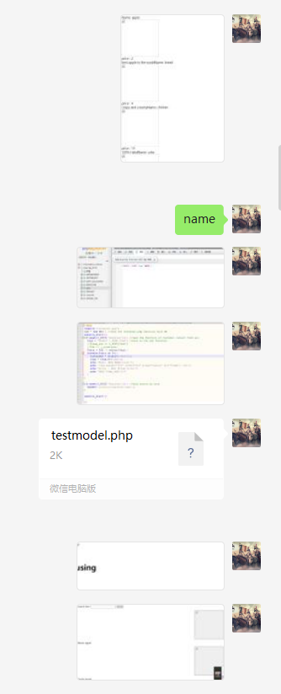
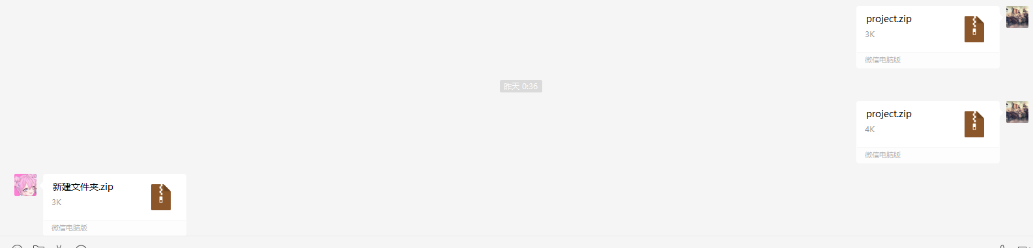
wechat share

Slide 4






User guide
01
03
Log in/sign in
Add items to your shopping cart
02
04
Use sort or click pic to check items
Check shopping cart

Slide 5

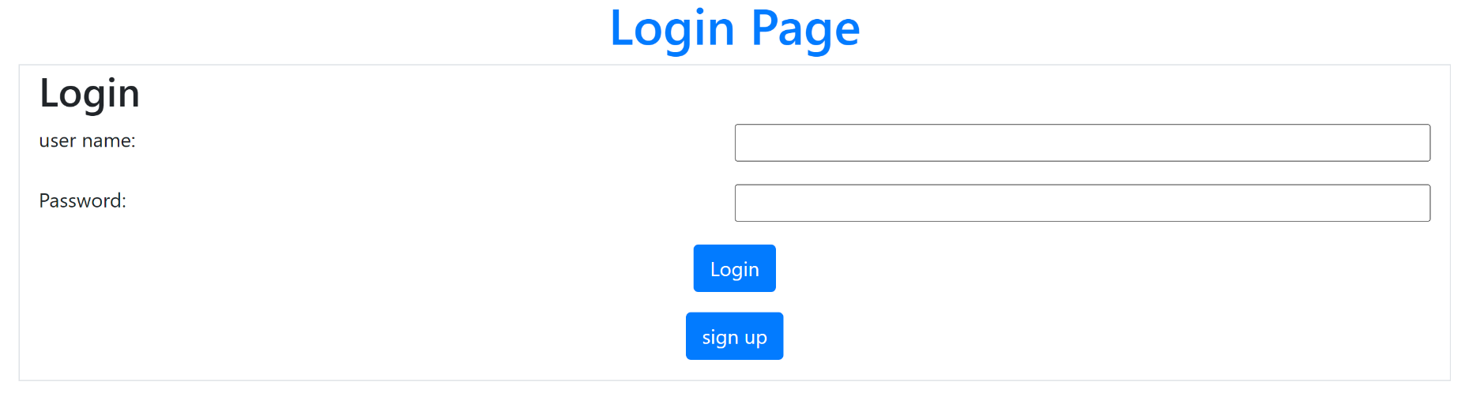
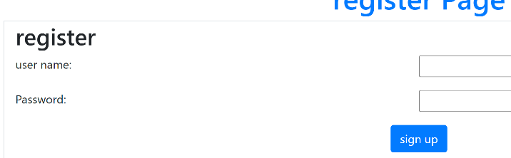
Log in/sign in
https://www.ypppt.com/

Slide 6

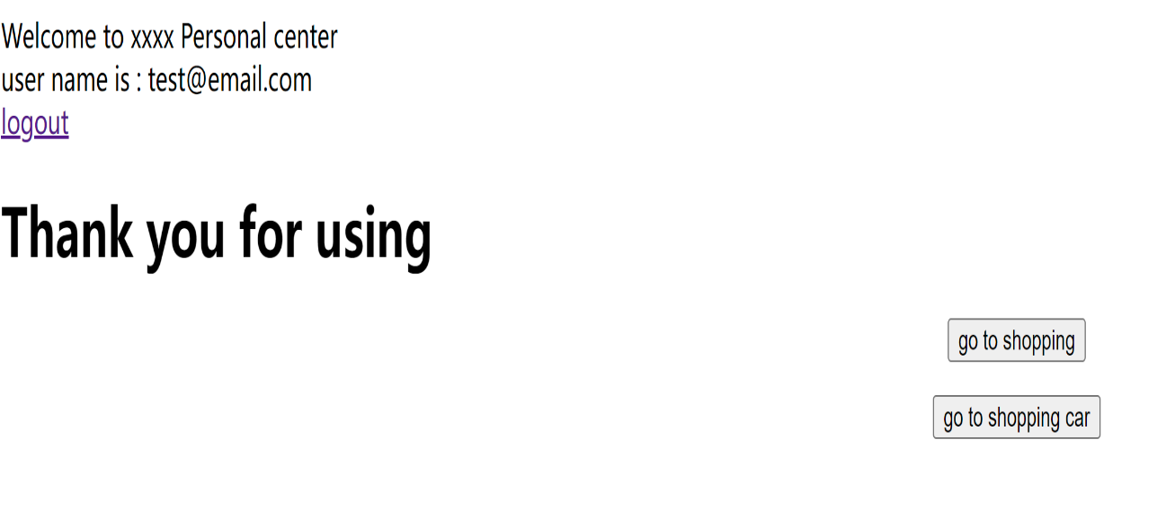
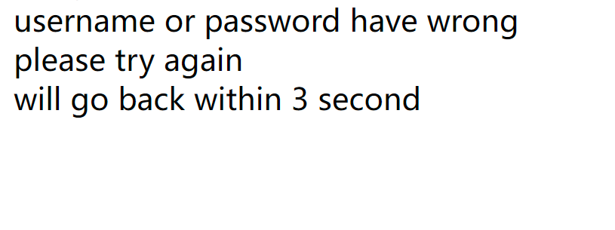
Alternative flows
If you don’t have your account yet you can click sign in to create one.
System will call error if input wrong username/password.

Slide 7

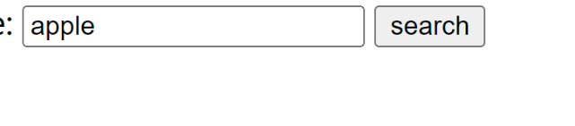

User can either use sort system or click item directly to check the item info.
02
Item page
Then user can add items into their shopping cart.

Slide 8

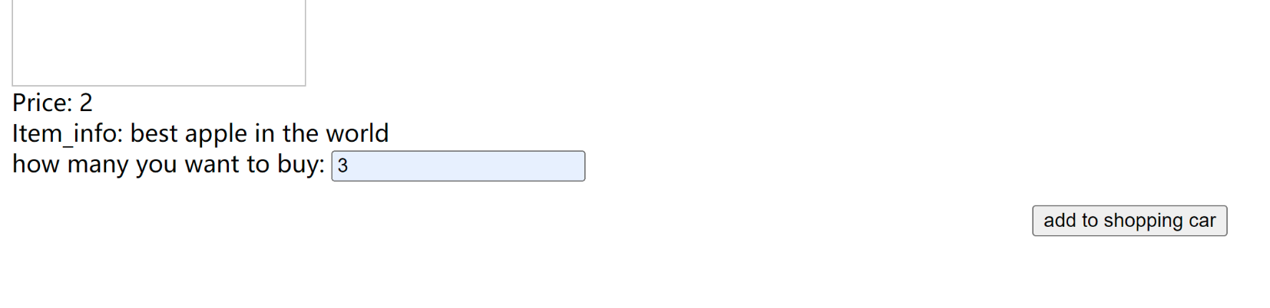

03 add item
User can input the quantity they want and add it into their shopping cart.
Alternative flow:
If entered 0, system will call error.

Slide 9

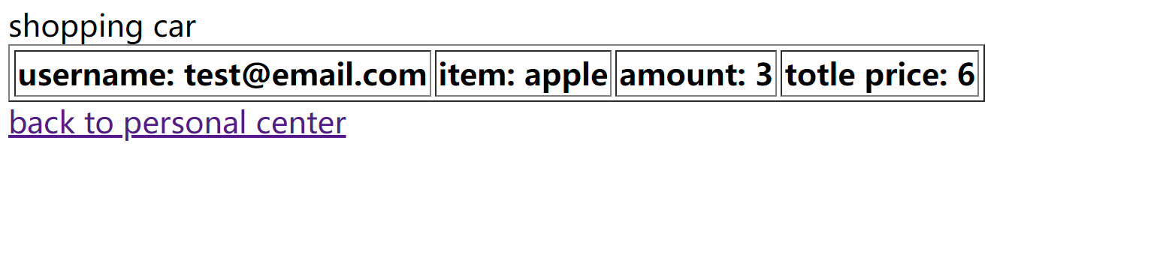
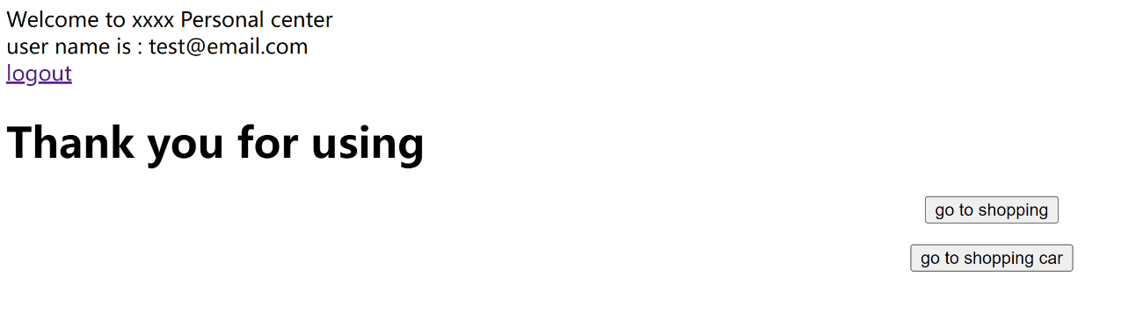
04 check shopping cart
On the personal center, there is another button” go to shopping car”, click it and see the items and price that being added

Slide 10

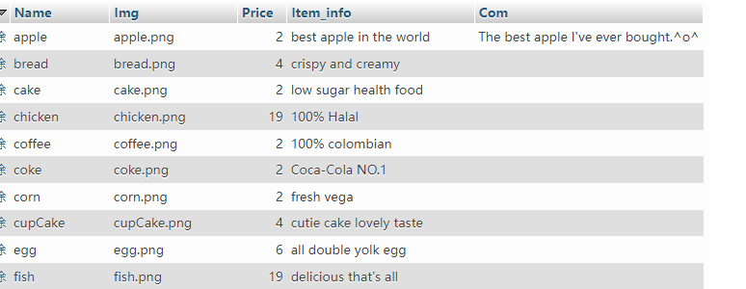
SQL(phpmyadmain)
We use the phpmyadmain from school computer to read the database.
Our database like here:
We save each item. img is means path. and we save each User evaluation in com in here use the”%sp”to splite them

Slide 11

SQL(phpmyadmain) Improve
User reviews are a big problem here. And it's easy to have more problems with cutting, so we plan to modify it in a way like shopping car. Let each item have its own comment and store it in each item.
We plan to bring more improvements and speed optimizations in the future.
the price in here can help us not read item price every time. Reduce possible problems

Slide 12
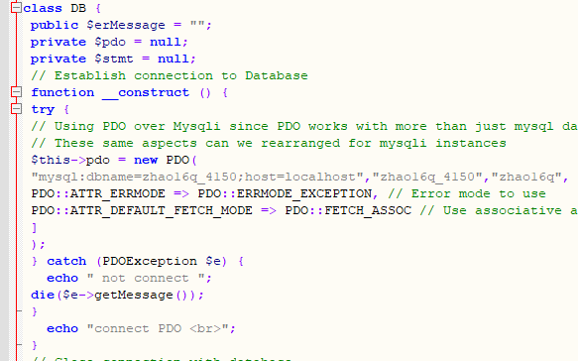
How to connect to database in php?
We use the PDO method to connect to the server, and configure the data in the insert, selec, and delete that may appear in it.
In the control file, we only need to enter the sql code to work directly on the database.

Slide 13

How to know the user id?
Use SESSION['username'] to facilitate us to record the login user name and use it to facilitate subsequent database queries.

Slide 14
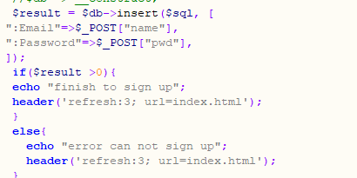
How to determine the possible primary keys are the same?
We used the method of making PDO return with a number. If the returned number is not greater than 0, it means that it cannot be stored. Although there may be other situations, in our test most of the reasons are the same because of the primary key.

Slide 15
Combined use of js and php
Because php sometimes does not help us get accurate item information. Incorporating the data we extracted from the database, it will appear that php does not know which data the user clicks to purchase. At this time, we choose to import js first from the html file to confirm and then import the php file.

Slide 16
More areas for improvement.
When reading and processing the information extracted by php, our main problem is that the html file that is used many times makes the operation slower.
Our running speed also has a lot of shortcomings in the user evaluation.
We didn't do UI design but just made a demo version, after that we need more aesthetic improvements

Slide 17
technologies used in this site
Html5
JavaScript
Php
Sql

Slide 18
Thanks for your watching
THANK YOU

